Slide 1
Sentiment Analysis on Amazon Product Review
Group: 2
Members:
Megha Ramesh
Amrutha Kulkarni Deshande
Pragati Dnyaneshwar Patel
B.Samyuktha Patnaik
Suraj Hiraskar
Darshan Balwant Shelar
Lakhan Patidar

Slide 2
Objective
Business Objective:
Need to get daily Analysis of a product such as emotions, sentiment etc. using Amazon data .It could be any product of your choice.
Architecture level analysis:
Need to pull the data of a product from Amazon
Data transformation/Text processing using R/Python
Need to get daily product sentiments Analysis and Emotion mining with some charts like histogram, Density plot, Barplot, pie-plot etc.
Deployment through R Shiny or Flask/ Streamlit

Slide 3
Libraries Used
Web Scraping : Requests, beautifulsoup
EDA : Pandas, numpy, sklearn
Visualization : seaborn, matplotlib, wordcloud
Text processing : nltk, Textblob, sklearn
Named Entity recocgnition : re, spacy
For model building : SVC, KNN, Bagging & Boositng, Random Forest, Logistic Regression

Slide 4

Methodology
1. Choose product
boAt Rockerz 370 Bluetooth Wireless On Ear Headphone with Mic (Buoyant Black)

Slide 5
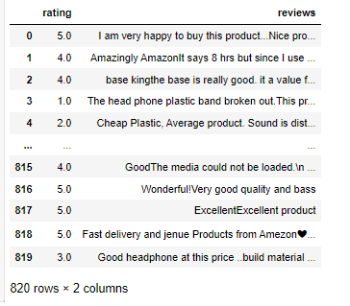
2. Extract reviews for product from amazon as a dataframe
Web scraping is an automatic method to obtain large amounts of data from websites. Most of this data is unstructured data in an HTML format which is then converted into structured data in a spreadsheet or a database so that it can be used in various applications.
‘requests ‘ is used to sent http requests using python
Beautifulsoup is used for webscraping and extracting relevant data.
Convert data into pandas dataframe format for further analysis

Slide 6
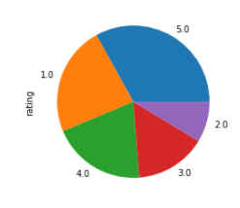
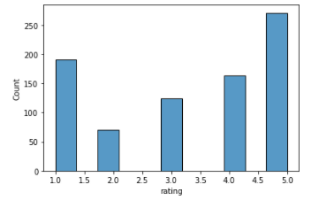
3. Data Preprocessing
Check for null values / duplicated values / missing values
Visualize data to understand
Findings
Highest vote count
Most common rating is 5. The second most common rating is 1. We can infer while the product has high number of positive reviews, it also has significant negative reveiws as well.

Slide 7
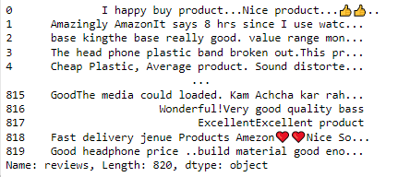
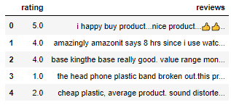
4. Text Preprocessing: text preprocessing is used to understand the information from the text data.
i) Analyse each review in terms of character count, special character count, numeric count and stopwords count
ii) Remove stopwords
iii) Convert words to lower case

Slide 8
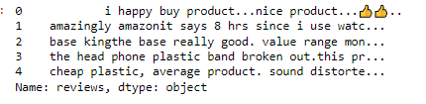
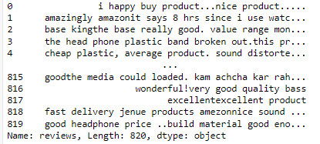
iv) Remove rarewords
v) Remove emojis and special characters

Slide 9
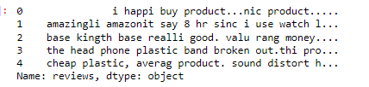
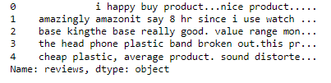
vi) Stemming and lemmitization

Slide 10
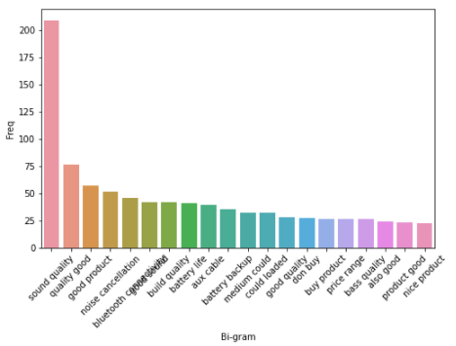
vii) Countvectorizer and ngrams
Ngrams : they are continuous sequence of words in a text block.
CountVectorizer : converts a collection of text documents to a vector of term/token counts
CountVectorizer with bi-grams

Slide 11
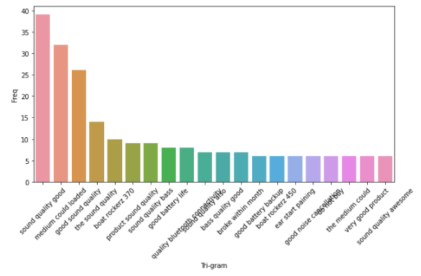
CountVectorizer with tri-grams

Slide 12
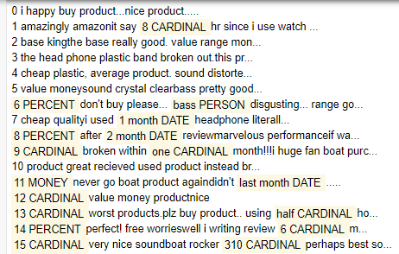
5. Named Entity Recognition : NER is probably the first step towards information extraction that seeks to locate and classify named entities in text into pre-defined categories such as the names of persons, organizations, locations, expressions of times, quantities, monetary values, percentages, etc.

Slide 13
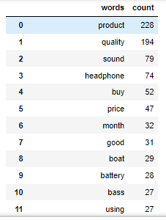

6. Extract nouns and verbs from the reviews

Slide 14
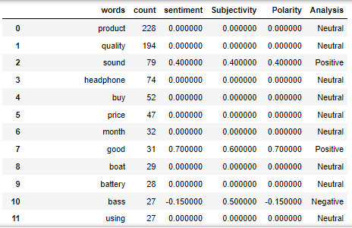
7. Sentiment Analysis : Sentiment analysis is a technique used to determine whether data is positive , negative or neutral.
When a sentence is passed into Textblob it gives two outputs, which are polarity and subjectivity. Polarity is the output that lies between [-1,1], where -1 refers to negative sentiment and +1 refers to positive sentiment. Subjectivity is the output that lies within [0,1] and refers to personal opinions and judgments

Slide 15
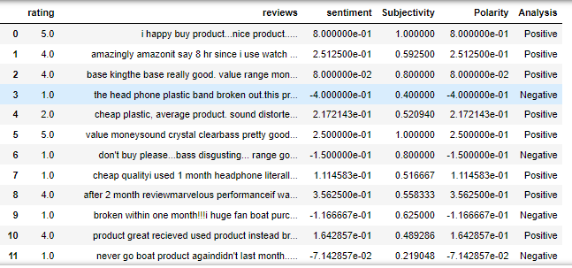
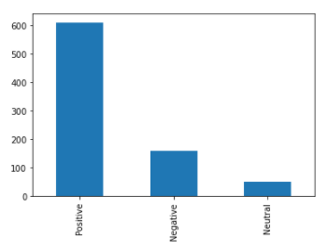
Sentiment Analysis for reviews

Slide 16
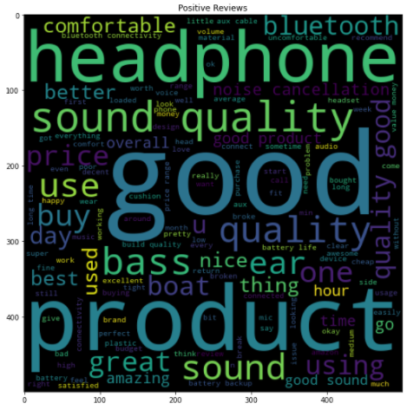

Slide 17
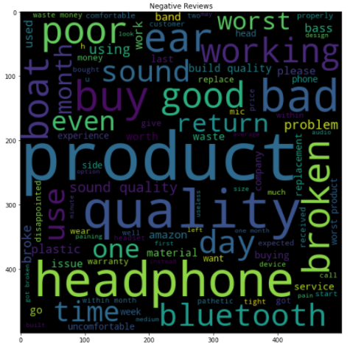

Slide 18
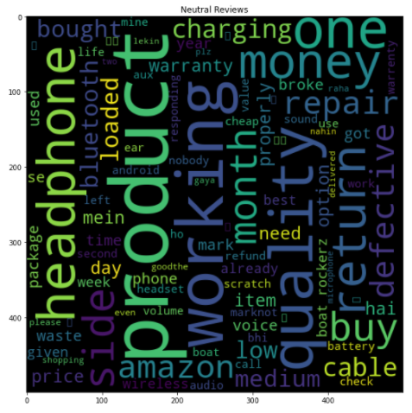

Slide 19
Model Building
Build and check accuracy for different models. The model with highest accuracy is selected for deployment.
Model | Accuracy (%)
SVC | 75.2
KNN | 79.7
Bagging Boosting | 80.8
Random Forest | 84.2
Logisitc Regression | 89

Slide 20
Deployment

